Slide 1
Quiz Game
Start Quiz
Notes:
You can also have points, scoring, report-card, shuffling questions and answers, exporting results to google sheets and more! Contact us for the same: contact@pptvba.com
Game built by PPTVBA.com - https://pptvba.com/how-to-make-powerpoint-quiz-game/
Thank you for downloading our free templates.

Slide 2
1. Which Indian company owns the brand Myntra?
a) Reliance Industries
b) Tata Group
c) Ajio
d) Flipkart

Slide 3
CORRECT ANSWER!🎉
d) Flipkart

Slide 4
2. Starbucks in India is known as:
a) Jio Starbucks
b) India Starbucks
c) Tata Starbucks
d) Cafe Starbucks

Slide 5
CORRECT ANSWER!🎉
c) Tata Starbucks

Slide 6
3. Which brand is associated with the slogan “Gives you wings”?
a) Monster
b) Red Bull
c) Pepsi
d) Mountain Dew

Slide 7
CORRECT ANSWER!🎉
a) Red Bull

Slide 8
3. Which brand is associated with the slogan “Gives you wings”?
a) Monster
b) Red Bull
c) Pepsi
d) Mountain Dew

Slide 9
CORRECT ANSWER!🎉
a) Red Bull

Slide 10

4. Identify the logo

Slide 11
CORRECT ANSWER!🎉
Tesla

Slide 12
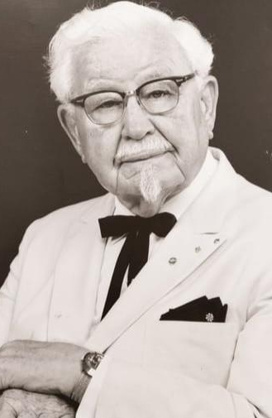
5. Identify the founder

Slide 13
CORRECT ANSWER!🎉
Colonel Sanders

Slide 14
6. ___ brand used the slogan “Connecting People”?
a) Vi
b) Nokia
c) Airtel
d) Samsung

Slide 15
CORRECT ANSWER!🎉
b) Nokia

Slide 16
7. Best platform for professional networking
a) LinkedIn
b) Facebook
c) Github
d) Instagram

Slide 17
CORRECT ANSWER!🎉
a) LinkedIn

Slide 18
8. Which soft drink brand is known more for sports than beverages?
a) Pepsi
b) Red Bull
c)Fanta
d) Coca cola

Slide 19
CORRECT ANSWER!🎉
b) Red Bull

